Slide 1
360 Degree feedback software for the government of India related News Stories in Regional Media using Artificial Intelligence/Machine learning – PSCS_35
CSE7101- Capstone Project
Review-2
Batch Number: COM_02
Under the Supervision of,
Dr. Pallavi M
Assistant Professor
School of Computer Science and Engineering
Presidency University
20221COM0049 | Thakkola Suprathika
20221COM0022 | Yerramsetty Poojitha
20221COM0048 | Siva Bhaskar Kora
Roll Number | Student Name
Name of the Program: COM
Name of the HoD: Dr. Pallavi R
Name of the Program Project Coordinator: Ms. Benitha Christinal J
Name of the School Project Coordinators: Dr. Sampath A K , Dr. Geetha A

Slide 2
Content
Abstract
Problem Statement
Objectives
Literature Survey
Existing Methods and Drawbacks
Proposed Methodology
Architecture Diagram
Modules
Implementation Progress

Slide 3
Content
Hardware & Software Requirements
Timeline (Gantt Chart)
Innovation / Novel Contributions
SDG Mapping
References

Slide 4
Abstract
Manual monitoring of government news is slow, error-prone, and lacks scalability.
Our project automates news collection, OCR processing, multilingual sentiment analysis, and alerting.
Focus: Indian regional languages + English + Hindi.
Outputs: Real-time alerts, department-wise classification, and structured reports.

Slide 5
Problem Statement
Current system: Manual/semi-automated news monitoring → slow feedback.
Challenge: Multiple languages, large number of sources, scanned newspapers, and social media.
Goal: Automate sentiment analysis and provide timely, accurate feedback to authorities.

Slide 6
Objectives
Classify news into positive, negative, neutral.
Develop multilingual NLP for Indian languages.
Integrate OCR for scanned newspapers.
Categorize department-wise (health, education, etc.).
Provide real-time alerts (SMS/Email/App).
Generate structured feedback reports.

Slide 7
Literature Survey
Reviewed 10 papers on OCR, NLP, Sentiment Analysis, and Indian languages.
Key Learnings:
Tesseract OCR is effective but needs preprocessing (Smith, 2007).
BERT works best for multilingual/code-mixed sentiment (Sharma et al., 2022).
OCR accuracy is still low in Indian languages (Smitha, 2021).
Deep learning > lexicon-based methods (B. Liu, 2012).
Aspect-based sentiment improves policy-level feedback (Kumar & Jaiswal, 2020).

Slide 8
Literature Survey
Sentiment analysis struggles with sarcasm/context (Cambria, 2017).
Indian languages face resource scarcity (Kumar, 2018).
Deep learning CNN/RNN advances (Zhang, 2019).
Social media news monitoring detects negative narratives faster (Gupta, 2021).
OCR+NLP integration validates novelty of our project (Patel & Mehta, 2020).

Slide 9
Existing Methods & Drawbacks
Manual methods: Slow, biased, lack multilingual support.
Automated tools: Mostly English only, limited accuracy in regional scripts.
No complete integration of OCR + NLP + Alerts in one pipeline.

Slide 10
Proposed Methodology
Pipeline:
Web scraping & OCR (for print clippings).
Text preprocessing & cleaning.
Sentiment analysis using multilingual transformers.
Department-wise categorization.
Alert generation + Dashboard reporting.
Significance: End-to-end system, multilingual, real-time, scalable.

Slide 11
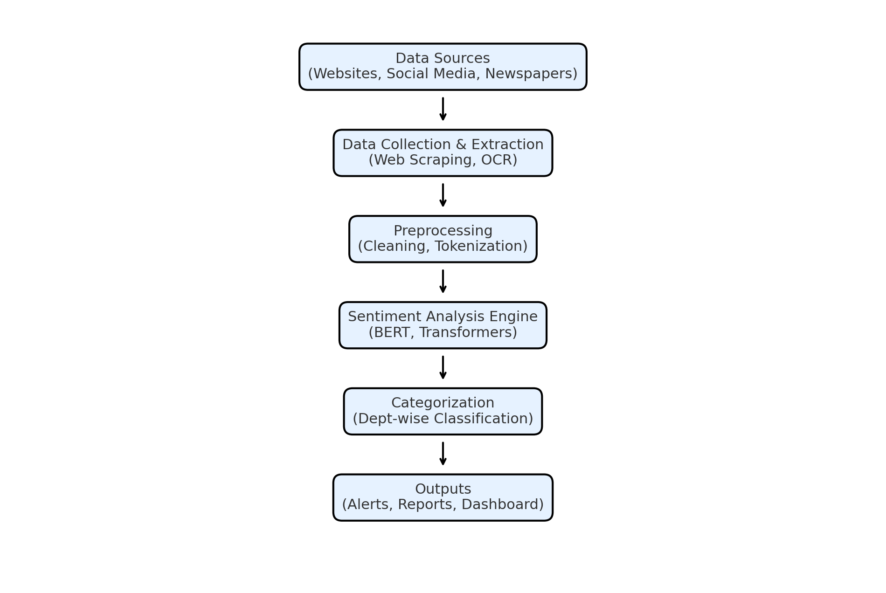
Architecture Diagram

Slide 12
Modules
Data Collection: Crawling ~200 news sites, OCR for scanned newspapers.
Preprocessing: Noise removal, tokenization, normalization.
Sentiment Analysis: Transformer models (BERT-based).
Categorization: Department-wise classification.
Alerts: SMS/Email/App for negative sentiment.
Reporting: Structured feedback reports for authorities.

Slide 13
Implementation Progress
Completed so far:
Kaggle Sentiment140 dataset integrated.
Transformer-based sentiment pipeline tested.
OCR module (Tesseract + TextBlob) tested on images.
In Progress:
Multilingual fine-tuning for Indian languages.
Department-level classification.
Planned:
Real-time alert system + dashboard.

Slide 14
Hardware & Software Requirements
Software: Python, Transformers, Pandas, Tesseract OCR, TextBlob, Django/Flask.
Hardware: Min. 8GB RAM, Dual-core CPU; Recommended GPU server for model training.

Slide 15
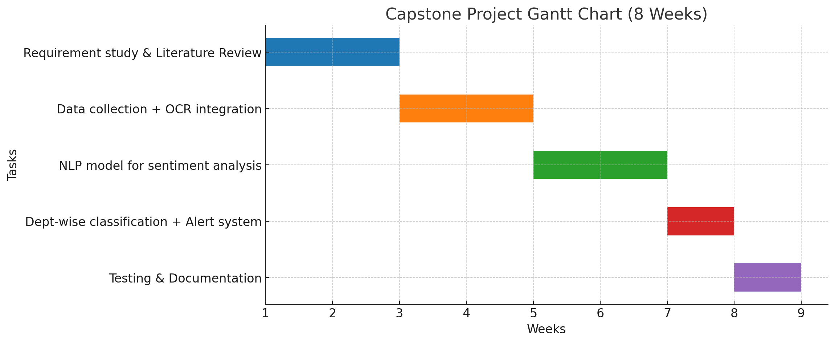
Timeline (Gantt Chart)

Slide 16
Innovation / Novel Contributions
End-to-end feedback system with multilingual support.
Integration of OCR + Sentiment Analysis + Alerts.
Department-wise categorization for policy-level insights.
Real-time negative sentiment alerts to government.
SDG Mapping
SDG 4 – Quality Education → NLP-driven awareness.
SDG 9 – Innovation & Infrastructure → AI-powered digital governance.

Slide 17
References (in IEEE format)
R. Smith, “An overview of the Tesseract OCR engine,” in Proc. 9th Int. Conf. Document Analysis and Recognition (ICDAR), Curitiba, Brazil, 2007, pp. 629–633.
D. K. Sharma, A. Kumar, and A. Joshi, “Multilingual sentiment analysis: Building and evaluating resources for Indian languages,” IEEE Access, vol. 10, pp. 45210–45225, 2022.
S. Smitha, “Applications of OCR Technology in Indian Languages,” in Proc. Indian Language Technology Conf., 2021.
B. Liu, Sentiment Analysis and Opinion Mining. San Rafael, CA: Morgan & Claypool Publishers, 2012.
A. Kumar and A. Jaiswal, “Aspect-based Sentiment Analysis in Indian Languages,” in Proc. Int. Conf. Computational Linguistics and Intelligent Text Processing, 2020.

Slide 18
References (in IEEE format)
E. Cambria, D. Das, S. Bandyopadhyay, and A. Feraco, “Sentiment Analysis: Is it Still a Challenge?,” IEEE Intelligent Systems, vol. 32, no. 6, pp. 8–63, 2017.
A. Kumar, R. Ranjan, and P. Bhattacharyya, “Sentiment Analysis for Indian Languages,” in Proc. Forum for Information Retrieval Evaluation (FIRE), 2018.
X. Zhang, J. Zhao, and Y. LeCun, “Character-level Convolutional Networks for Text Classification,” in Proc. Advances in Neural Information Processing Systems (NeurIPS), 2015, pp. 649–657.
R. Gupta and A. Joshi, “News Sentiment Analysis on Social Media Data for Governance Applications,” in Proc. Int. Conf. Data Science and Engineering (ICDSE), 2021, pp. 112–117.
V. Patel and M. Mehta, “OCR and NLP Integration for Automated Document Processing,” in Proc. Int. Conf. Computational Intelligence and Communication Networks (CICN), 2020, pp. 245–250.

Slide 19


